Slide 1
Azure container registry
Creating a registry and deploying that container

Slide 2
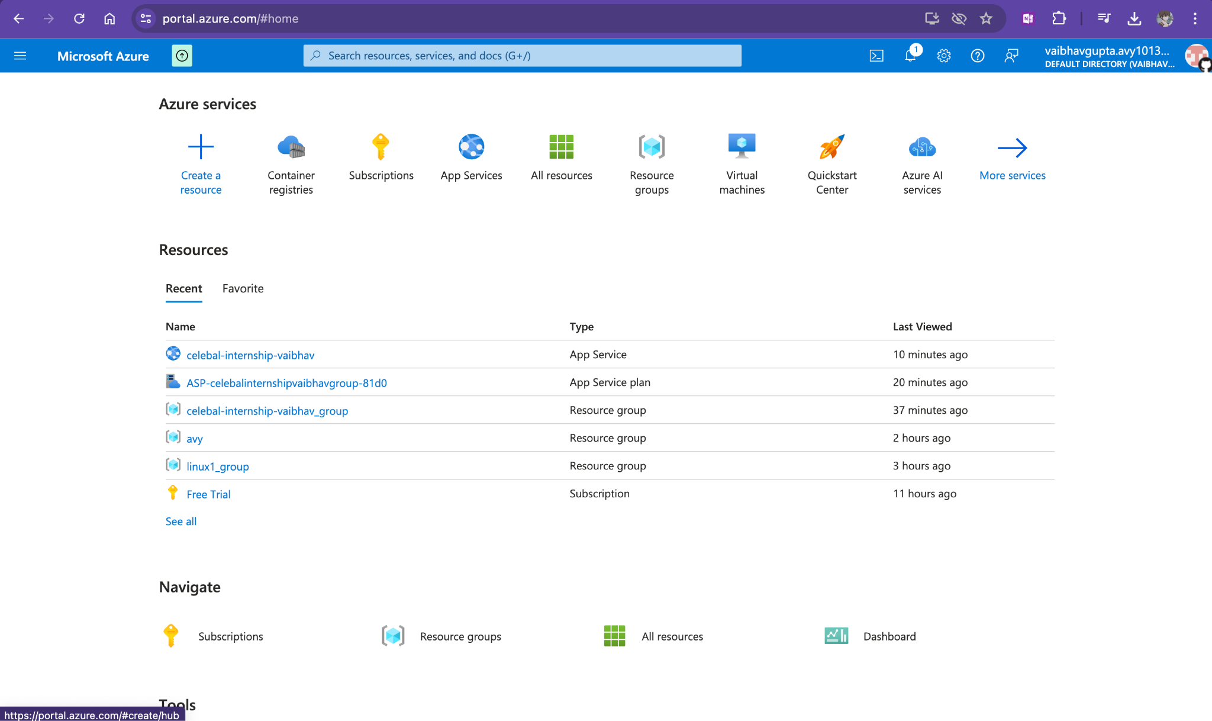

Slide 3
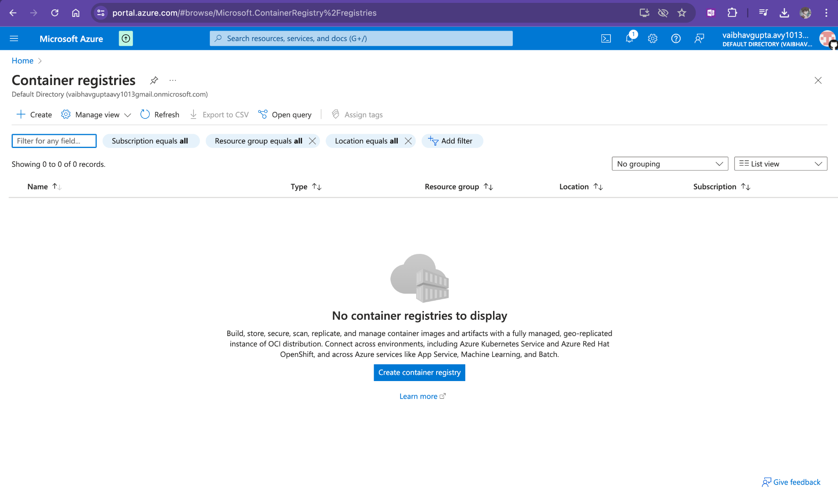
CREATING REGISTRY

Slide 4
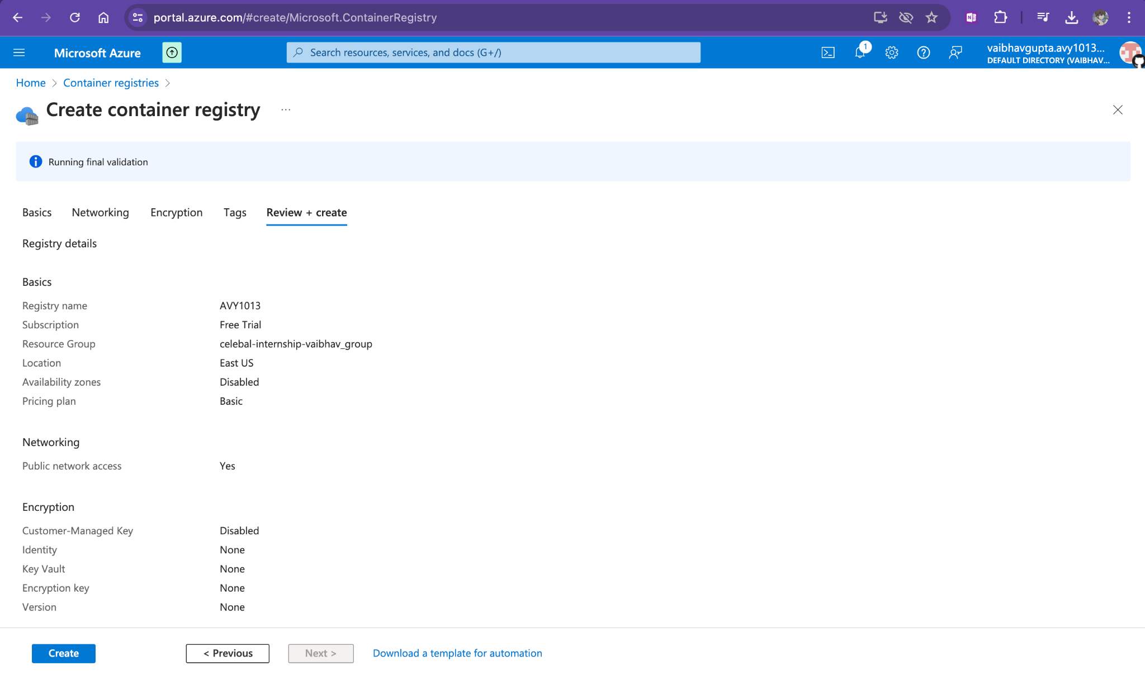

Slide 5
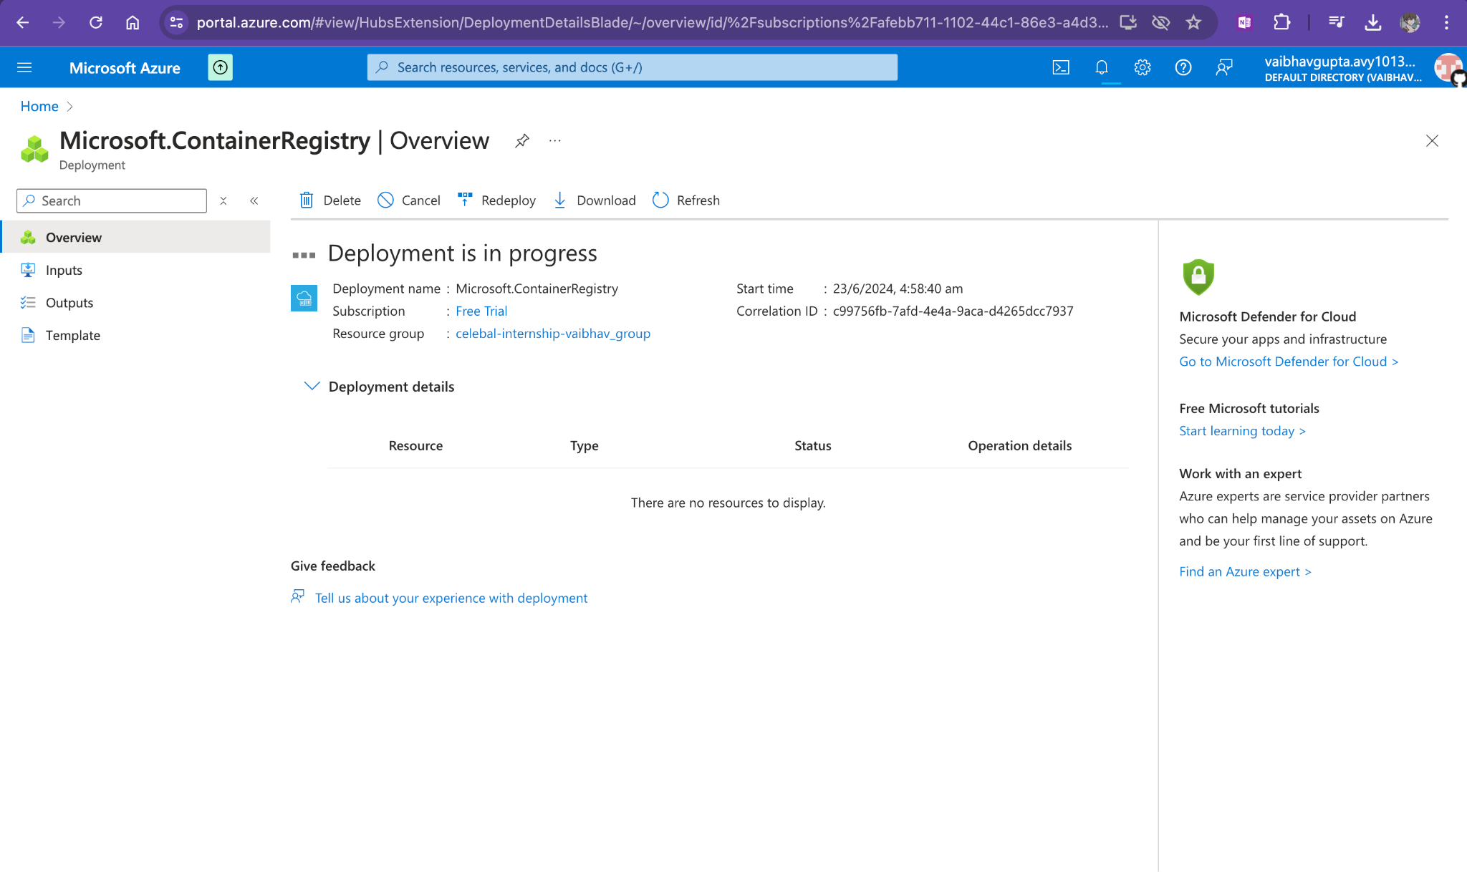

Slide 6
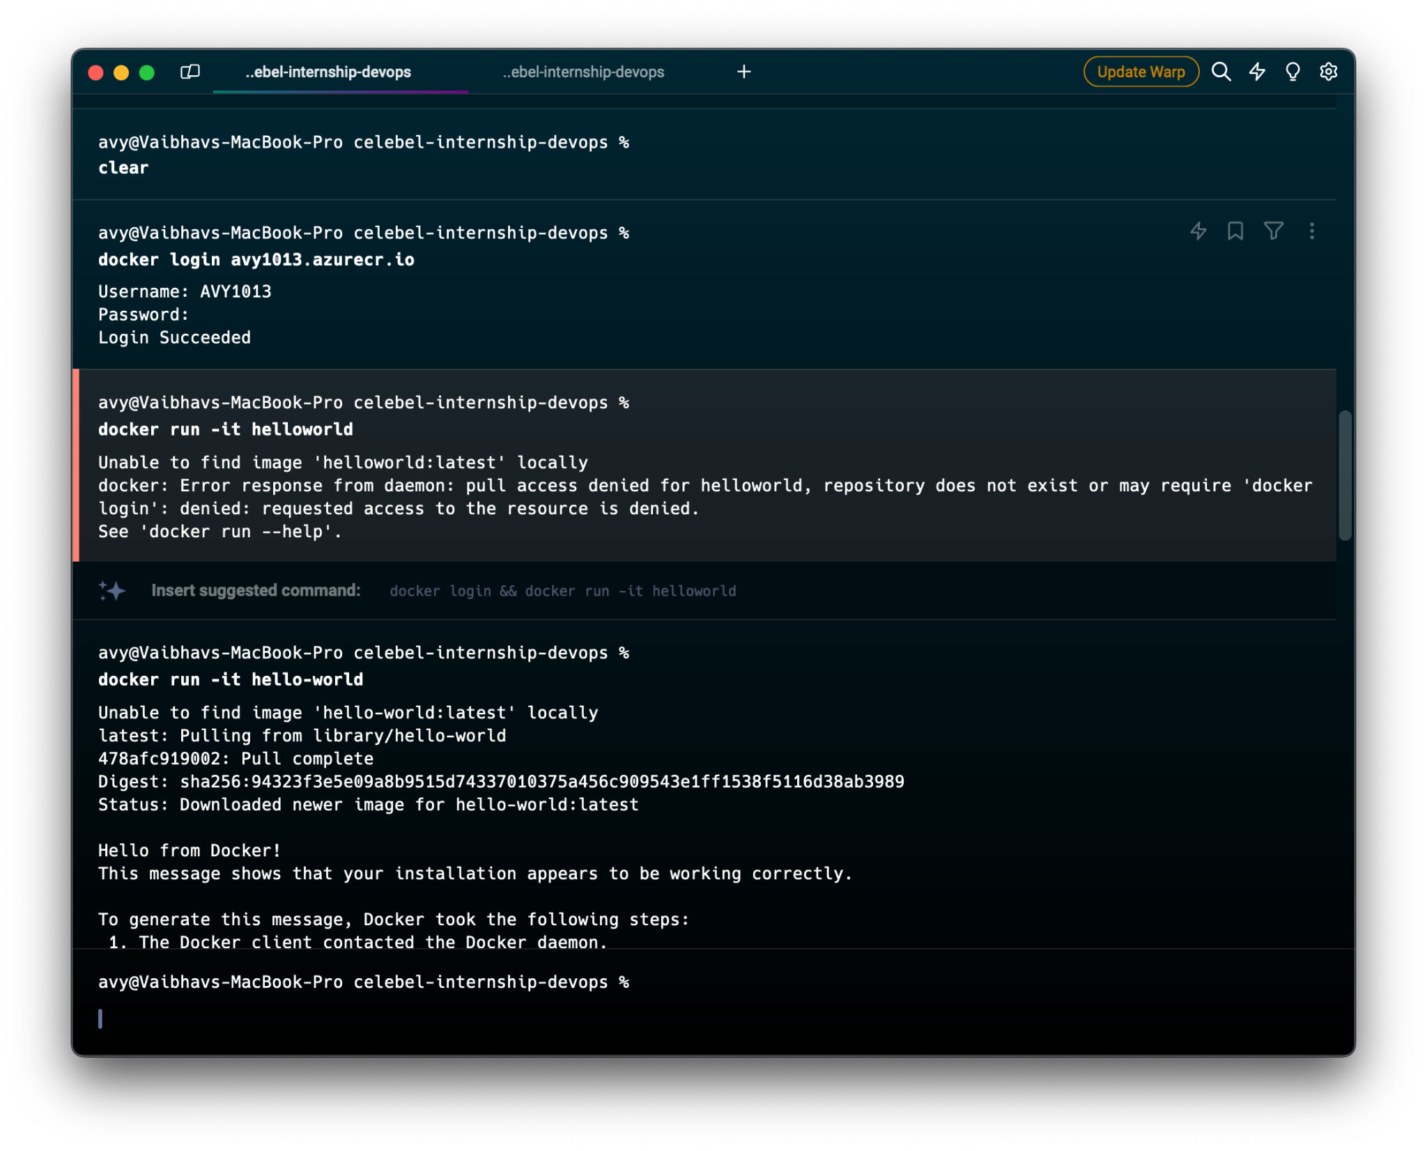
LOGGING IN REGISTRY

Slide 7
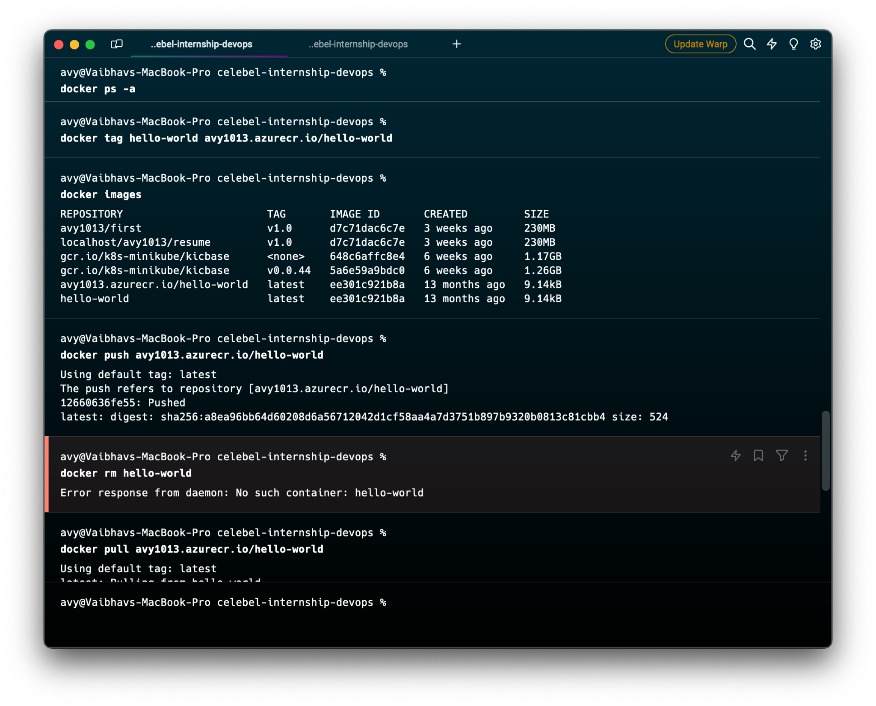
Pushing the image on registry(ACR)

Slide 8
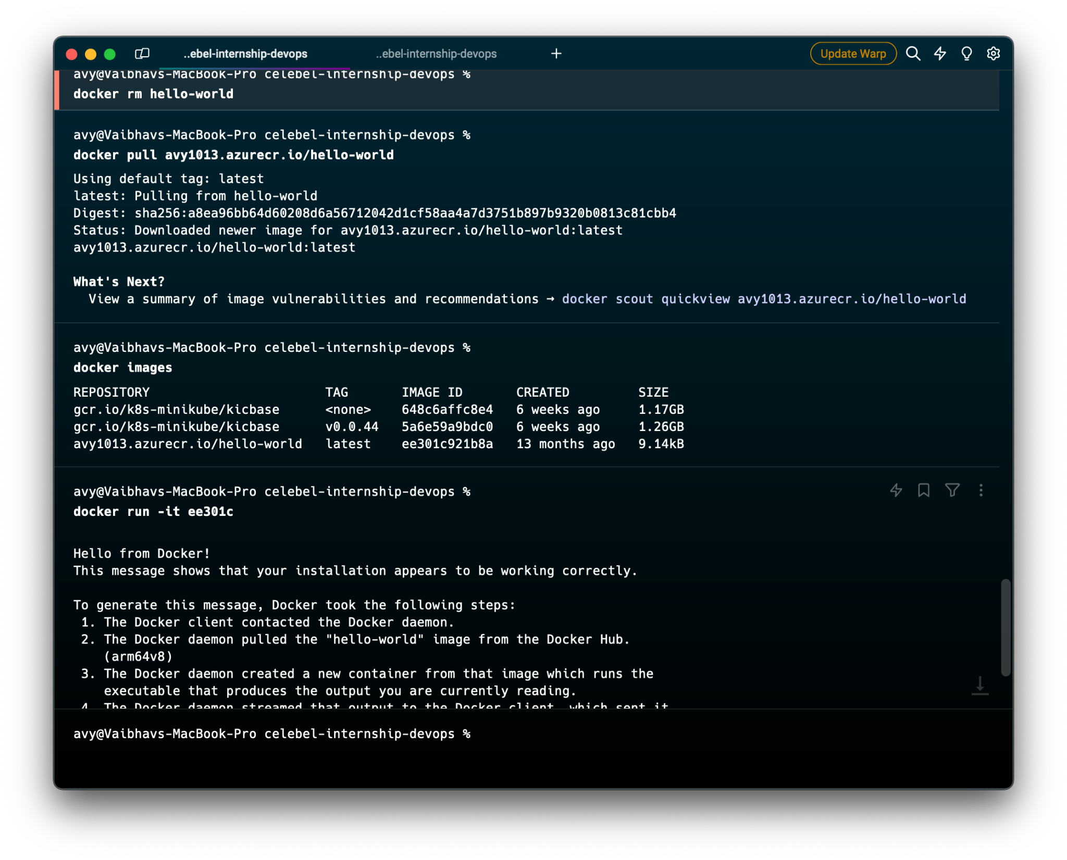
Successfully able to pull image and run it

